Slide 1

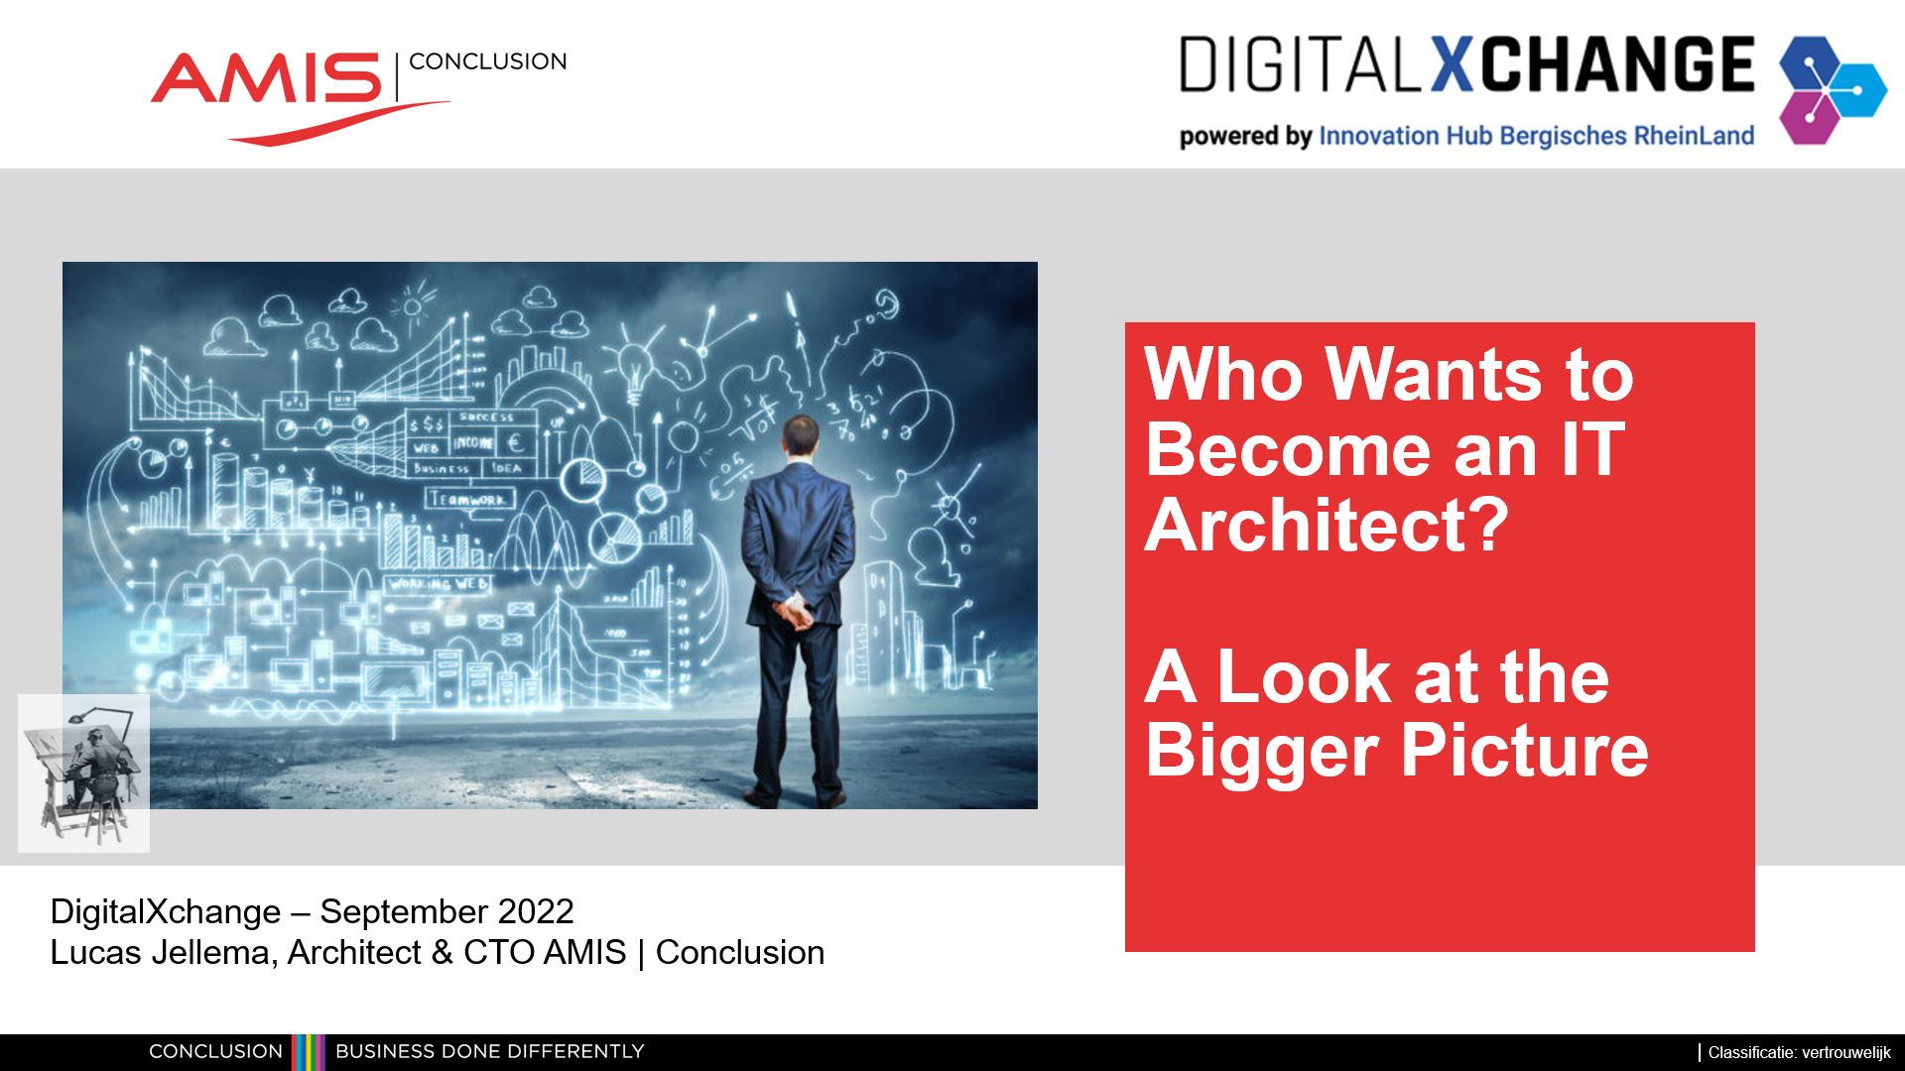

Slide 2


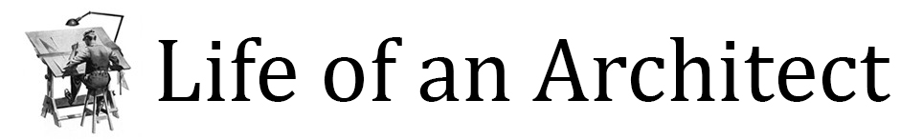
Who Wants to Become an IT Architect? A Look at the Bigger Picture
DigitalXchange – September 2022
Lucas Jellema, Architect & CTO AMIS | Conclusion
Notes:
The movie The Matrix made it clear: The Architect is powerful. How to be(come) and IT architect? What do you do, what do you need to know, is it fun and why? Using real world examples, core principles and useful tools, this session introduces the subtle art of designing and realizing flexible IT architectures. Taking a step back to get and create an overview, frequently asking why to get to the real intention, bringing aspects such as cost, scale, time and change and business strategy into the design and bridging the gap between business owners, process managers and technical specialists. One way to define the responsibility of an IT architect. In this session, we will discuss what is expected of the architect and what you need to do for that and what you could use to get it done. How do you get started as an architect, how to grow in that role? We discuss a number of real life architectural challenges and solution design. And discuss a number of architecture principles, patterns, and powers to apply. Never stop programming – but perhaps rise to the architecture challenge too.

Slide 3


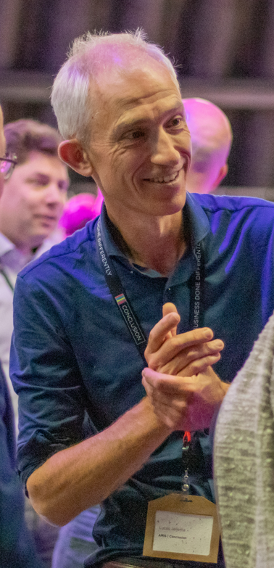
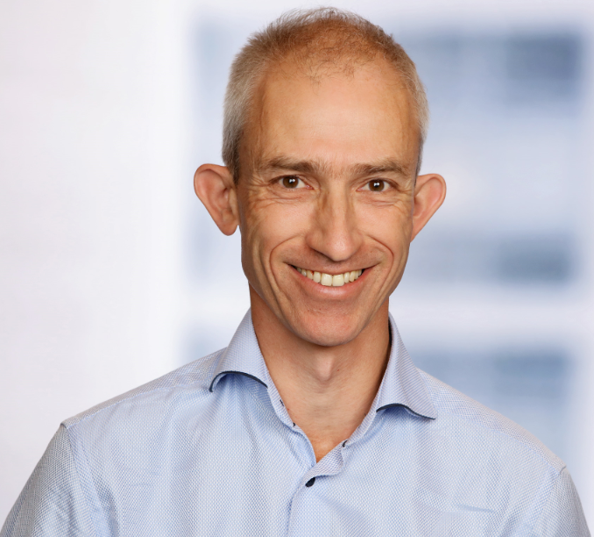


80 colleagues, located in Nieuwegein
Founded in 1991 by students from University of Twente – Aircraft Maintenance Information System (AMIS)
the core of what we do: working with Data.
partnering with peers and companies in several countries
Lucas Jellema (2002)
Cloud Solution Architect & CTO
lucas.jellema@amis.nl | technology.amis.nl | @lucasjellema | lucas-jellema

Slide 4
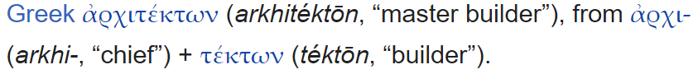
Architect

Slide 5
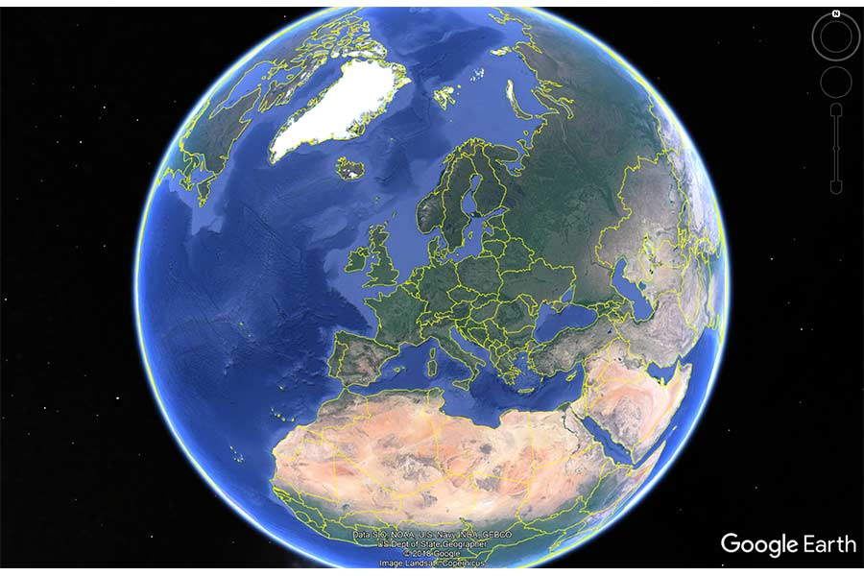
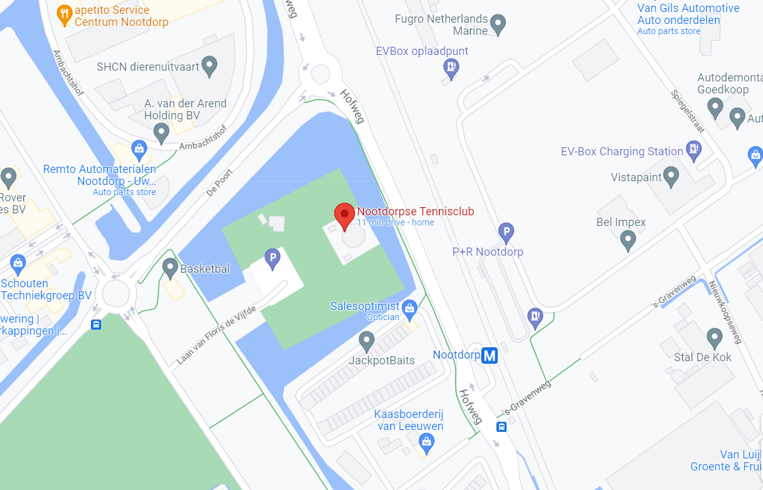
From A(bstract Idea) to Concrete
A
C

Slide 6


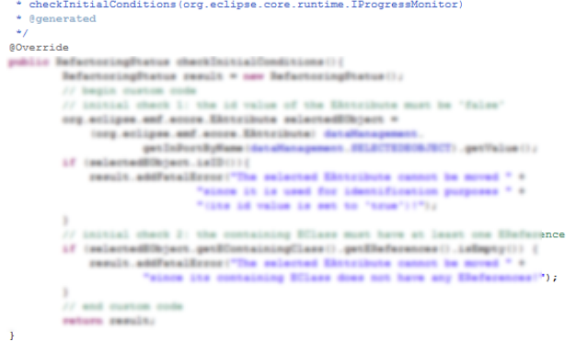

From What (via Why) to How?
Grand Vision, Business Value, Big Idea
Implementation & Roll Out to Production & Operate

Slide 7
From What (via Why) to How?
WHAT
Architecture
HOW
Business Analysis
WHAT

Slide 8
From What (via Why) to How?
Enterprise
WHAT
HOW
why?
Domain
glossary
value
chains
domains
roadmap
data model
HOW
WHAT
WHAT
WHAT
design decisions
debt
Functional Debt
epics
WHAT
HOW
Solution
WHAT
Tech Debt
Ops Debt
application & feature portfolio management
Team Process Debt
impact analysis
technical life cycle management
solution design
Software
TCO
WITH WHAT
bdd
KPI analysis & monitoring design
HOW
HOW
WHAT
stories
WHERE
non-functional requirements
technical design
HOW MUCH
WHEN
WITH WHAT
WHAT
WHAT
WHO
WHAT
functional requirements
use cases
WHAT
WHAT
test scenarios
WHAT

Slide 9

Virtual Architect
No Architect role in Agile
The Team
There Sure is Agile in Architecture
continuous need to evolve, grow, embrace change
Agile needs Architecture
solid, evolving foundation to deliver features on top of
Another team will build the UI
On Board Australia – scale up to 23/7, much larger load and 20K km latency
Drop vendor X
ChatBot as an additional UI

Slide 10
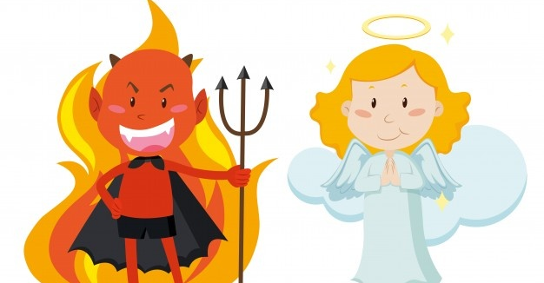




Good Girl, Bad Boy
Art vector created by brgfx - www.freepik.com
Co-create, facilitate big idea, explain and provide opportunities, create roadmap, listen, Order from Chaos
Keep asking why, press for non-functionals, demand decisions, claim budget for LCM & Debt mgt,
Product Owner
Architects
(peers)
Architect
(you)
The World
(vendors, community, ..)
Sell, Enlist, Guide, Listen, Explain, Visualize, Paint the Picture (“of how it’s gonna be”), Convince, Empower, Demonstrate
focus on quality and debt control, clamor for adherence to standards and design decisions, point out weak spots
Product Owner
The Team

Slide 11
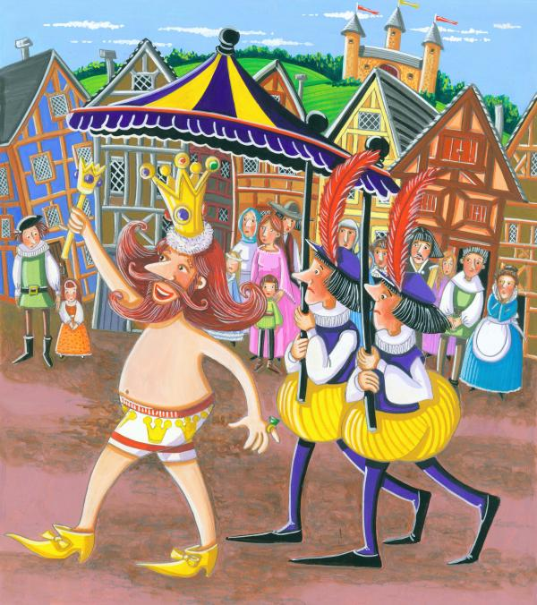

Dare to be that little girl

Slide 12

You’d Better Think
also think further, harder and deeper and with imagination (what if?)
PO’s scope is inch deep – and often Quarter long
team’s scope is sprint
developer’s scope is story or task

Slide 13

Which & How Much Technical Knowledge is required?
Look ahead – trends, roadmaps, vendor strategy
Assess viability – if, when, for what (and what not)
Understand complexity (including devil’s details)
Critically approach vendors
Explain to & Discuss solution design with team
Assess team’s efforts
Retain credibility
IT Architect != Ivory Tower Architect

Slide 14
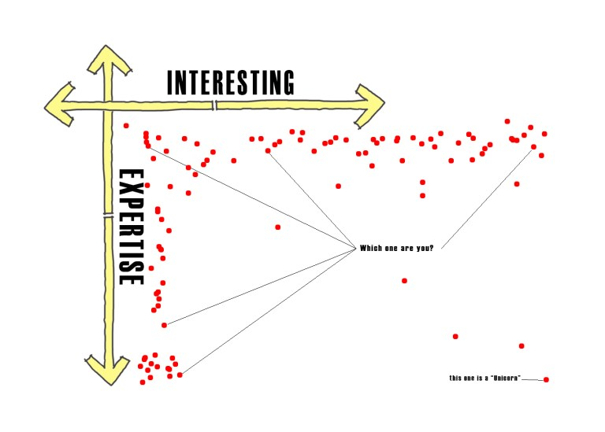
Things to Know About
SQL
API
Project => Product
Cache
Serverless
6R
Containers
REST
Cloud
TCP/IP
HTTP
Kafka
Decoupling
Notebook
Kubernetes
GraalVM
Event Driven Architecture
DevOps
GDPR
Agile
Encapsulation
Microservices
Infra as Code
Multimodal Database
Terraform
Automation
Transaction
Monolith
Pay per Use
Event Sourcing
CQRS
Reactive
Green IT
CI/CD
Spark
Dependency Injection
Elasticity
[reverse] proxy
Edge Device
NoSQL
Sidecar
QR Code

Slide 15

BOL - CQRS

Slide 16

Books Online - WebShop
Products
Webshop visits
searches
product details
Orders
Product updates
Read only
Online (most of) 24/7
Speed is crucial
XHTML & JSON
> 5M visits
Data manipulation
Data Quality (enforcement)
<10K transactions, business hours
Batch jobs next to online
Speed is nice
firewall

Slide 17


Nightly generation
DMZ
Webshop visits
searches
product details
Orders
Products
Products
Products
Products
Product updates
Read only
JSON documents
Images
Text Search
Scale Out Horizontally
Cheap
Stale but consistent
Read only
Online (most of) 24/7
Speed is crucial
XHTML & JSON
> 5M visits
Data manipulation
Data Quality (enforcement)
<10K transactions, business hours
Batch jobs next to online
Speed is nice
firewall

Slide 18
Comand Query Responsbility Segregation = CQRS
Products
Data Manipulation
Data Retrieval

Slide 19
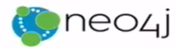



Comand Query Responsbility Segregation = CQRS
Products
Data Manipulation
Quick Product Search Index
Special Products
Data Retrieval
Toys
Product Clusters
Product Store in SaaS app
Food Stuff
Notes:
Data manipulation and retrieval in separate places
(physical data proliferation)
Query store is optimized for consumers
Level of detail, format, filters applied
For performance and scalability, independence, productivity lower license fees and lower TCO, security

Slide 20

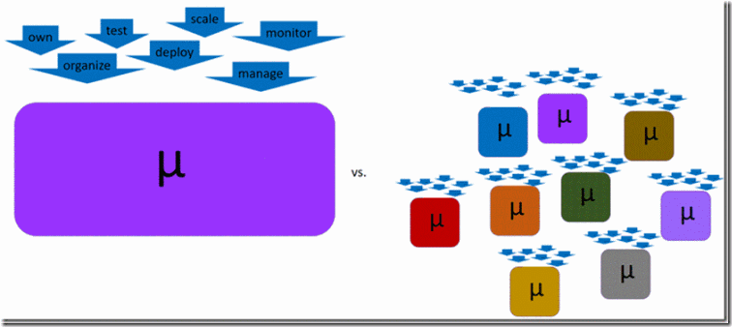
microservices
What is a microservice?
How many microservices should we have?
How big should the microservices be?
Essence of microservice
autonomous – including data
owned by one team
implement | change | rollout | run| scale | move | secure | … independent of others
objectives: controlled & sustained agility in functionality and operations
Notes:
https://technology.amis.nl/tech/when-the-cracks-begin-to-show-on-designing-microservices/

Slide 21
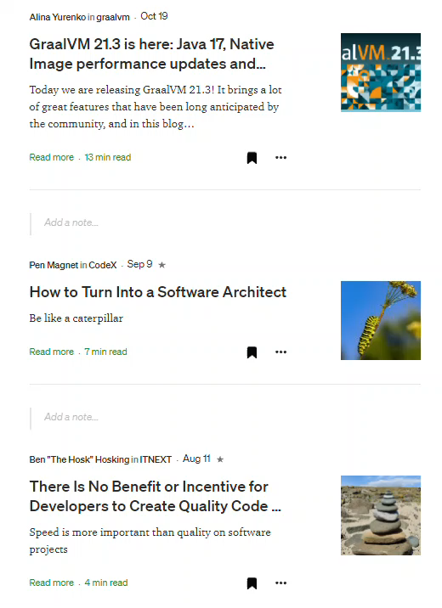
How to Stay Up-to-Date?
Attend Conferences (virtual or physical)
Listen (and Talk) to Team
Spar with Peers
Read (and Watch)
out of the box
Ask [feedback]
Participate in Debates & Workshops
Track Vendors and Analysts (critically!)
Try things out
Write
Present
`My Recent Reading List on Medium.com

Slide 22
Instruments for Breaking Down and Building up
Interview
Power questions
Diagrams / Visualizations
Tools – whiteboard, ArchiMate & Archi, EA, draw.io, PowerPoint/Visio
Wiki
Wisdom of the crowd
Patterns, Reference Architectures, Case Studies, Best Practices
Prototypes
Roadmap
Architecture Design Decisions [Log] & Periodic Architecture Review (DCAR)
Glossary
[Meta] Data Catalog
Debt Registry and Risk Log
Definition of Ready – including approved solution design

Slide 23
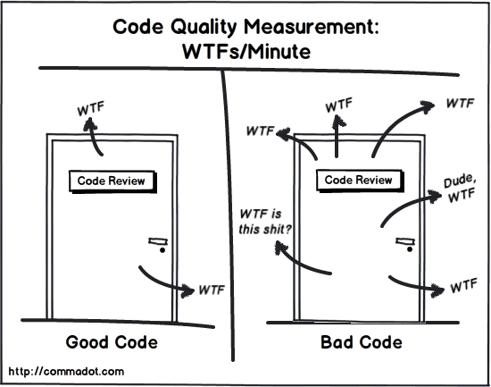
Draw & Visualize

Slide 24
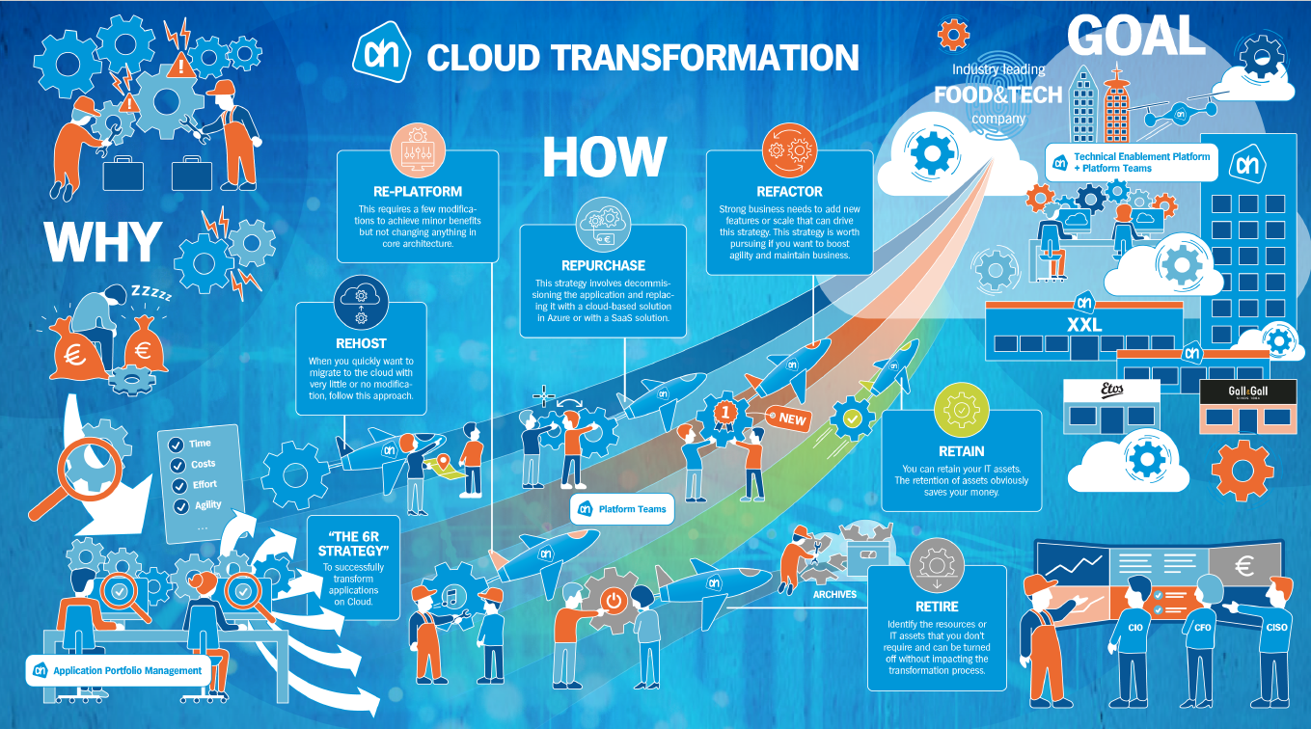
Pharmaceutical

Slide 25

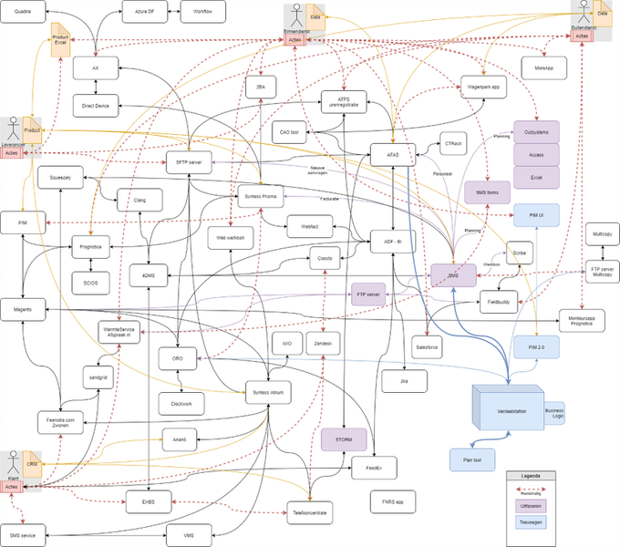
Visualize Systems, Components, Dependencies, Persistence, Boundaries

Slide 26








Zoom Out [in time] to the Bigger Picture What happened at the Financial Institution
Average time from mail delivery to start processing: 2.5 days
Time to process: 10-30 minutes
Process Changes
[BPM Workflow Engine]
Average delivery period: 1.5 days
Generate Financial Status Statements
Financial & Personal Data

Slide 27
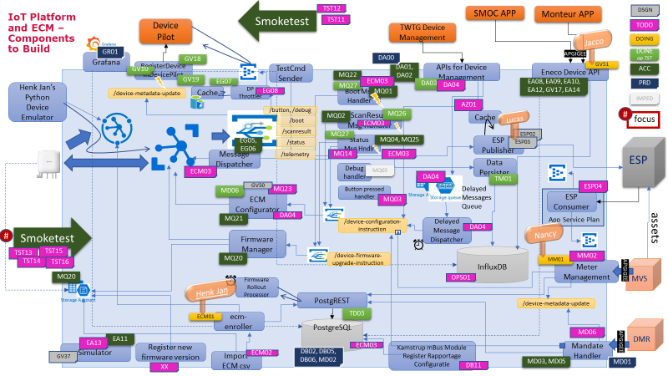
Mapping User Stories to Solution Design & End 2 End Flows

Slide 28

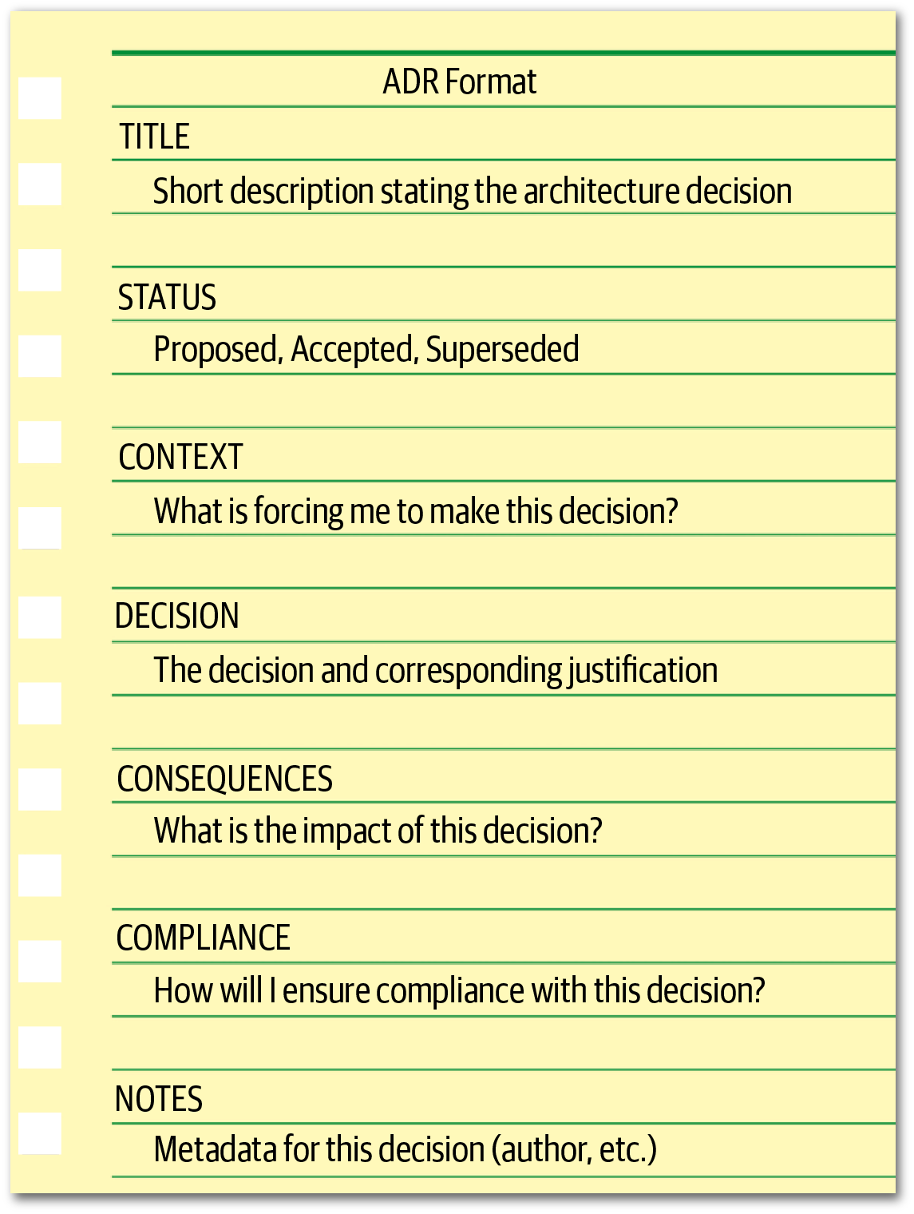
Architecture Design Decisions [Log]
and Dare Revisit
Dare decide –
balance ideal vs reality of budget | time | culture | legacy | skills |
What has been| is being | will be decided?
Per decision
label & title
what, why & when
current status (could be superseded)
context: place in bigger picture, relation with other decisions
criteria – based on what will we come to a decision
what are the options to choose from
what did we decide
why? why not the alternatives?
who & when
consequences/impact/actions
if and when should we evaluate? until when is decision valid?

Slide 29
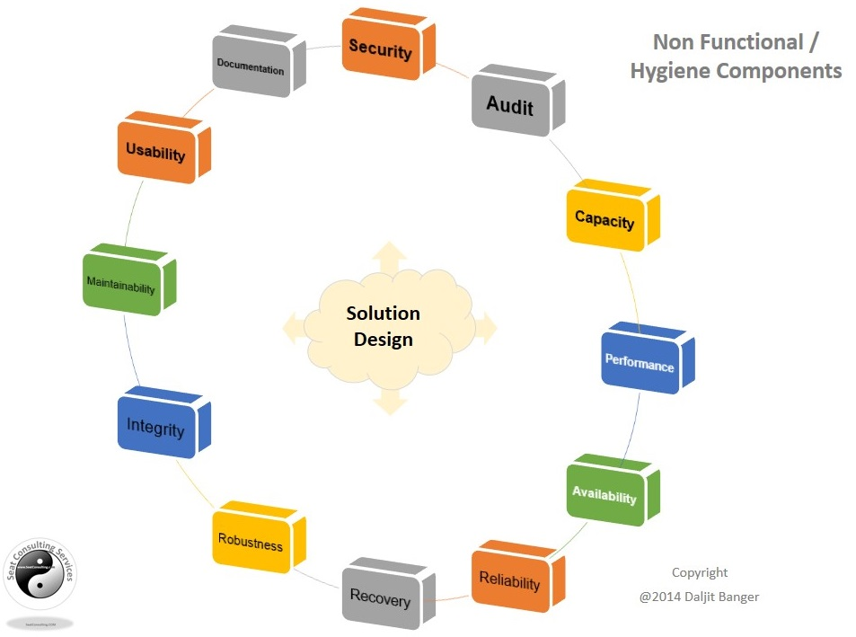
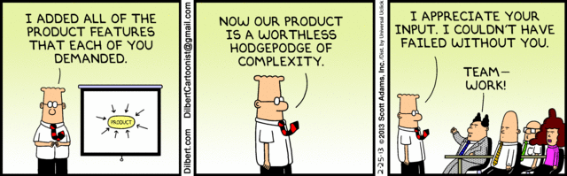
Non Functional Requirements
When, where, who, how often | fast | good | much | reliable
allowed margins for error | slower responses | unreliability | down time | data loss | security
And why [again]? what if not? How much may it cost? How green should it be?
to build? To operate? To maintain & evolve?

Slide 30

Average Number of …. (be so aware)
Be aware of average
dike built to withstand “average water height”
Number of messages | service calls | user sessions is 10M per day
Average Number of messages | service calls | user sessions is 400K / hour or 7K / min
Ask for Peaks, Trends And for response times: p95 (the time within which 95% of requests should be handled)
# of msg/min
# of msg/min
50K
7K
1K
time ->
time ->

Slide 31

Fine Grained Non-Functional Requirements Analysis Zooming Out Too Much at the Utilities Company
Highly Available – no more than a few minutes down time per month
Event Platform on Kafka
3G
Each device sends four quarter hour measurements every hour – and includes data from past 12 hours
APIs
10K – 150K devices
in consumer homes
and businesses
The IoT Platform
Cloud Based on Azure

Slide 32


Fine Grained Non-Functional Requirements Analysis Zooming Out Too Much at the Utilities Company
Highly Available – no more than a few minutes down time per month
the device provisioning process carried out by field engineers on weekdays between 7AM and 6PM
Mobile App
PostgreSQL Device DB
API
Event Platform on Kafka
IoT Hub
Function
3G
Function
Function
Function
Each device sends four quarter hour measurements every hour – and includes data from past 12 hours
Influx DB
APIs
10K – 150K devices
in consumer homes
and businesses
Event Grid
The IoT Platform
Cloud Based on Azure

Slide 33
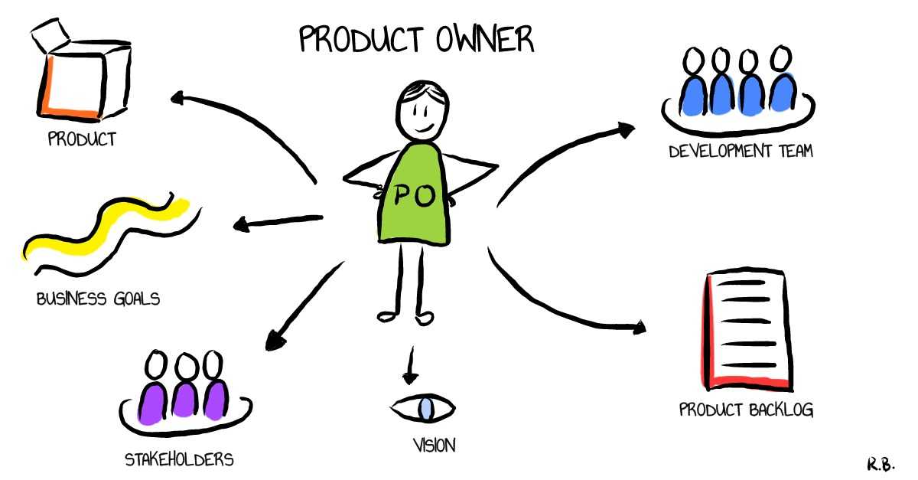
Architect is Product Owner regarding Technical Viability
Health now and later
current technologies (N or N-1), supported and on vendor’s strategic roadmap, skills available within and outside organization, community enthusiasm, feature fit for known and foreseeable future, teams’ prowess and eagerness
Perform Technical Life Cycle Management
for Application and Platform
and stimulate application and feature portfolio management
Manage Technical Debt
and push for management of other types of debt
TECHNOLOGY ROADMAP
letsscrumit.com/scrum-roles-2-product-owner

Slide 34
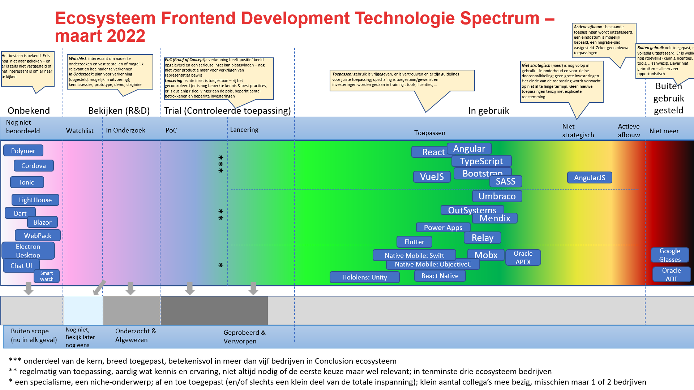
Technical Life Cycle Management
Know what technical components you currently have in use
where, for what
Highlight status of components
for example in a Technology Radar or Spectrum
Score products/applications for their actual TLCM status
and define corrective actions
Good, Preferred
‘Second best’, Acceptable for now
Deprecated, do not use for new, replace if you can
Disallowed, replace ASAP
Under investigation; cleared for prototyping

Slide 35
Product ( Team | Project) Technology Fingerprint - template
Work Item Backlog Management, Agile Process management, Issue/Incident Management, Collaboration, Communication, Wiki
3rd party services
SaaS of on-prem standard applications
Code Editing, Source Code Control, GitOps, “Linting”, productivity boosters
UI & API technologie (web app, mobile app, chatbot, REST & Graph QL API, WebService), IoT & Edge Device
HTTP, WebSocket, SSE, HTML, JS, CSS, SVG, REST, GraphQL, React, D3, Angular, VueJS, Material UI, Cordova, Next.js
HTTP, WebSocket, SSE, JS, Python, REST, GraphQL, Express, Apollo, HTTP/2, gRPC
Agile Process
Front End
Software Engineering
User Interface
Programmatic Interface
API Management, Load Balancer (level 7), ETL/Data Pipeline, Data Connectors, Data Catalog, CDN, Data Analysis & Visualization, Device Management, Digital Twin, Streaming Analytics, AI
Application
Develpoment
Java, Kotlin, Python, Node, SQL, PL/SQL, Spring Boot, Struts, Express, Pandas, KSQL, JDK 15, Kafka Connect, MQTT, JMS, Parquet, JDBC,
language, framework, library, protocol, format
language, framework, library, protocol, format
Behavior Driven, Code Analysis & QA, Unit, UI, Integration/E2E, Load, Pen Testing
Test & QA
Back End Business Logic
Platform
Health Check
Managed PaaS or stand- alone products (OSS or COTS)
Container Platform, Serverless Functions, Operating System, Language Runtime, Web & Application Server
CI/CD pipelines, Automation, Infra/Platform as Code, Build, Artifact Management
Application Runtime
Data Persistence
Security
Generic Operational Facilities
Build & Release
Database, Event Bus, Cache, Data Lake, Streams, Blockchain
Identity & Access Management, Authorization, Key Vault, Audit, SIEM,
Infrastructure
Compute (VM, Bare Metal), Network, VPN, Storage, Firewall, Load Balancer (level 4), Appliances, Engineered Systems, on prem hardware
Monitoring, Log Mgt & Analysis, Cloud Cost Control, Health checks, Alerts & Notifications, Job Scheduling & Mgt, Resource Management, Configuration
Run Time
Design Time

Slide 36














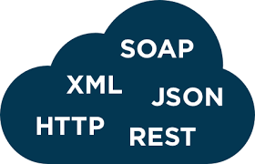





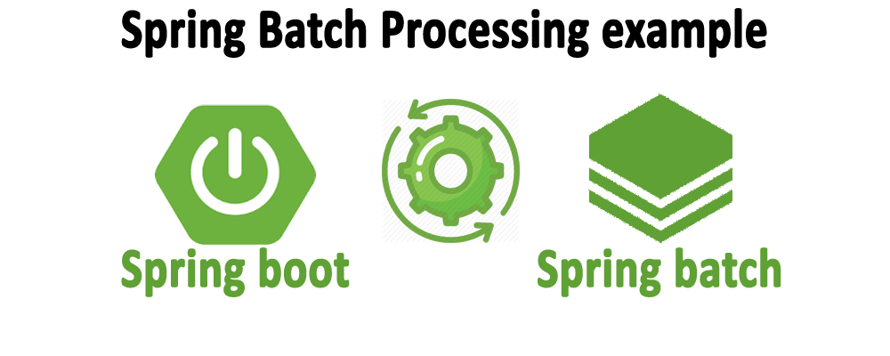
























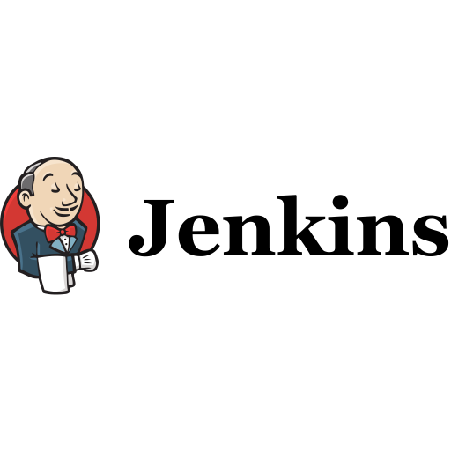

Product Team XYZ - Technology Fingerprint as of 15 August 2022
3rd party services
Support
Agile DevOps Process
Monitoring
Front End
Software Engineering
Test & QA
CICD
Platform
Scripting
Data Persistence
Security
Infrastructure
Run Time
Design Time

Slide 37
Technical Life Cycle Management at Energy Logistics Company
Home grown ERP system tailored to unique business processes – used at 20 sites around the world by 150 users
Oracle Forms & Oracle Database (PL/SQL loaded)
Small team – business savvy, decade experience on current system
business unhappy with innovation speed
warning signs around current technology stack (Forms dates back to ‘80s)
Consulting Firm recommended: adopt Agile process and Oracle ADF (Java based) and complete replacement of current Forms application on top of existing database
IT department had no web development or Java skills, no agile capabilities, no real technical eagerness for new stuff (no professional software developers)
After three years, they abandoned the ADF/Java Stack and picked APEX
the project is still hard going – but the team is much happier and productive
Note: Oracle Forms is still going fairly strong – ADF has all but disappeared
PL/SQL
APEX
Forms
ADF

Slide 38

Debt Mountain of products & teams
Architect
Tech Debt

Slide 39
Technical Debt
Owner: Architect (*
Found during: Dev, Code QA, Review
Tech Debt
Ops Debt
Hard coded styles in web pages
Low (to no) test coverage
Complex, deeply nested, large, hard to understand code units
Meaningless or even confusing variable names
High degree of coupling
Low quality documentation
Magic numbers (hard coded values) in program code
Use of deprecated òr unsupported technologies
Use of exotic features that no one understands but Jim
Manual steps in CI/CD
Frequent substantial redesign of architecture/ platform / tech stack
Libraries with security vulnerabilities
Use of technologies not known or wanted by team
Impact/Risk (Longer Term)
Changes increasingly become harder (lengthy, costly, risky) – low agility
Hard to keep/find & motivate technical staff
Drop in Team Productivity (velocity)
Production incidents
Increased Vulnerability

Slide 40

Debt Mountain of products & teams
Functional Debt
Product Owner
Architect
Tech Debt
Ops Debt
Scrum Master
Team Process Debt
Team
Organization Debt
Community Debt

Slide 41

What to do about debt?
Identify debt during
refinement, review, test, Ops intake, retrospective, audit, on boarding
analysis, development, production usage
Make debt explicit and visible – in a debt register and the risk log
what and where
severity, risk and impact (running cost!)
resolution: how and effort
Discuss debt (risks, running cost of not fixing) & plan actions
in every sprint planning
in every steering committee session
…
Continuously work on reducing debt – in small steps
boy scout principle (improve everything you touch)
explicitly set sprint budget aside
Debt status should be a Team KPI
Focus on a root cause: Team Process Debt
Functional Debt
Risk Log
Tech Debt
Ops Debt
Debt Register
Team Process Debt
Organization Debt
Community Debt
Team Story Backlog

Slide 42
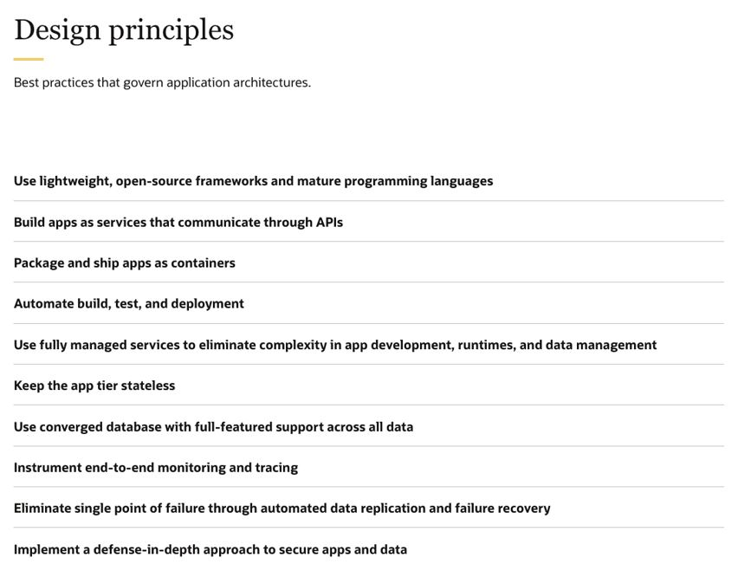
Prevent or at least Manage Tech Debt
Design Principles & Reference Architecture
Architecture Design Decisions
identify/define
process for deciding
prototype, spike, evaluate
record
Application and Feature Portfolio Management & Technical Life Cycle Management
usage and state => risk
effort to upgrade or replace
Team Process:
Definition of Ready – include solution design (how & non functionals)
Definition of Done
Peer Review
source: Oracle Cloud Reference Architecture
Notes:
lijst van design decisions
die gaan komen, nu spelen en recent genomen zijn
per beslissing
wat (waar in het grotere solution design van de Data Market)
waarom & wanneer
eventueel samenhang met andere Design Decisions
overwegingen/criteria - op basis waarvan gaan we de keuze maken/alternatieven beoordelen
welke opties/alternatieven onderkennen we
keuze plus motivatie (en wie waren betrokken)
moet er een PoC vooraf of evaluatie achteraf worden gedaan?

Slide 43


Breach of Contract – at Dutch Court Systems (no obvious technical debt)
users could no longer submit court cases
eCase
Portal
Team UI
Composite Business Service
Team Linking Pin
Entity Service
a check constraint was added on a database table to enforce a rule on the data records
Court Cases DB
Team On Your Case

Slide 44


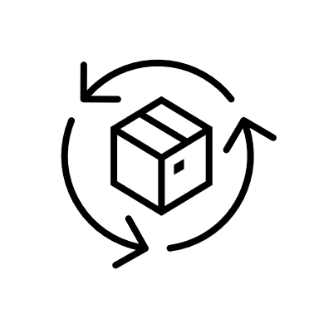
Breach of Contract – at Dutch Court Systems Process Refinement
Automated End-to-End tests – run on Acceptance environment after every change
eCase
Portal
Team UI
Composite Business Service
Team Linking Pin
Every team prepares test set
for other teams to automatically run when they roll out any changes
Entity Service
Court Cases DB
Team On Your Case

Slide 45
Architect’s Self Training
Think in Systems
subsystems, interactions, decoupling, boundaries, flow, state & persistence
coffee machine

Slide 46
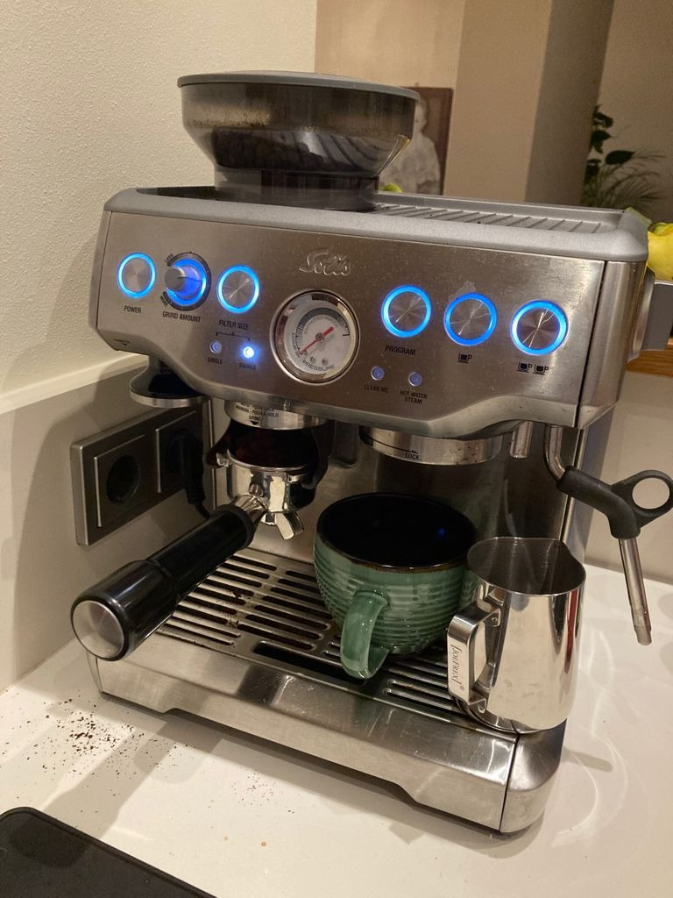

Look for Architecture in everyday life

Slide 47
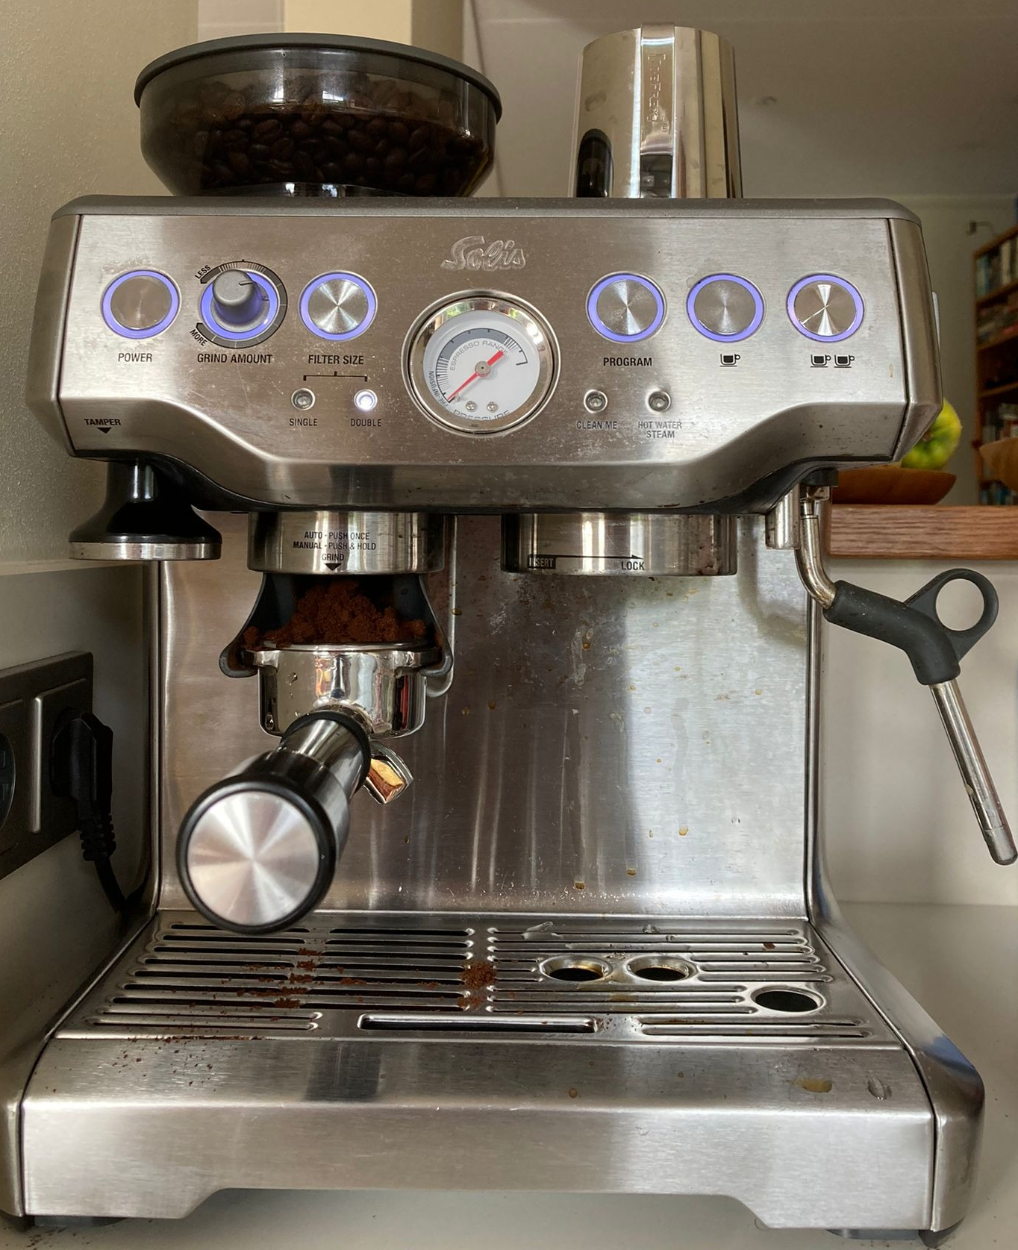
Coffee Machine Platform & App Services
2
Platform
Power
Water
Waste
Casing & Rack
User Controls
App Services
Grind Beans
Brew Coffee
Produce Hot Water
Produce Steam
A
5
C
D
B
4
1
3

Slide 48

Coffee Machine Platform & App Services Proper Architecture Visualization
UI
Grind Beans
Brew Coffee
Heat Water
Generate Steam
power
waste
water
Platform
water
power
Rack

Slide 49
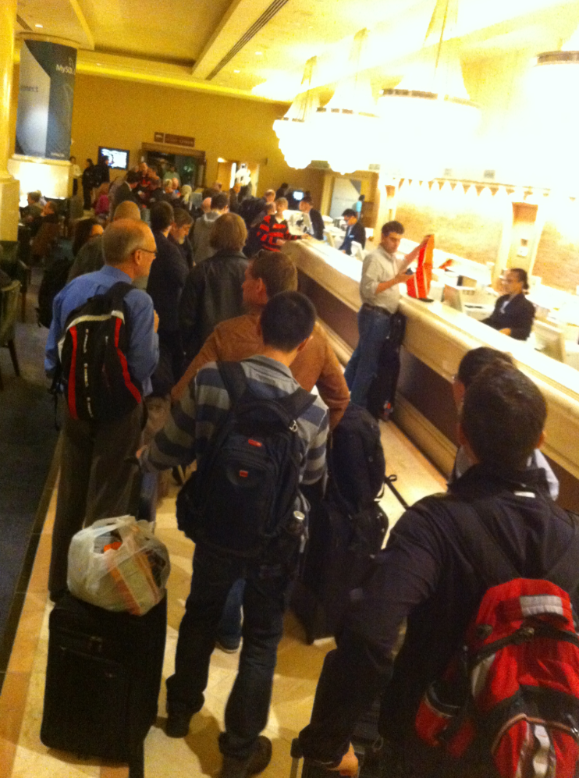

Architect’s Self Training
Think in Systems
subsystems, interactions, decoupling, boundaries, flow, state & persistence
coffee machine
Use Metaphors and Analogies -
Pinboard for event broker
Telephone for synchronous/asynchronous
Check in desks in hotel or highway lanes for scale out

Slide 50
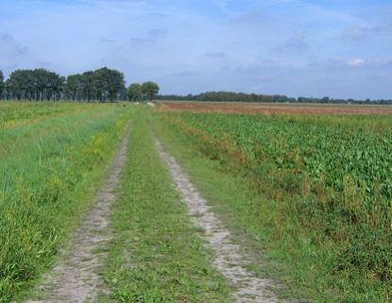

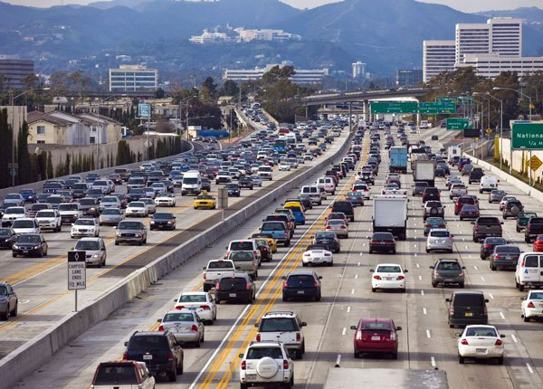
Use Analogies
Scale Up
Scale Out

Slide 51


Architect’s Self Training
Think in Systems
subsystems, interactions, decoupling, boundaries, flow, state & persistence
coffee machine
Use Metaphors and Analogies -
Pinboard for event broker
Telephone for sync/async
Check in desks in hotel or highway lanes for scale out
Get your hands dirty: try things out
Architecture Katas
do not trust brochure – vendors often do not know themselves
Talk, spar, brainstorm – bounce ideas, challenge and look for challengers
IT Architecture != Ivory Tower Architecture
Read: cases, technology, hypes, …
Gartner – management trusts them

Slide 52

Pitfalls
Too Complex, Overengineered
Does not Scale
Misinterpreted Requirements
Technology does not work as advertised
Team does not play along
[fail to manage] Business expectations
No business value generated (too much focus on platform)
Impossible to Operate
Environment has changed
Out of Touch (with technology reality)
`source: https://www.bitrix24.com/about/blogs/tasks-projects/five-common-planning-pitfalls-and-how-to-avoid-them.php

Slide 53
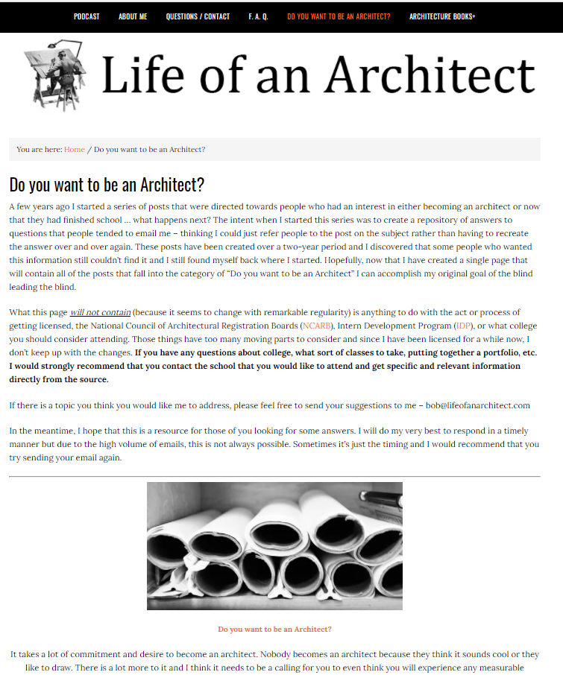
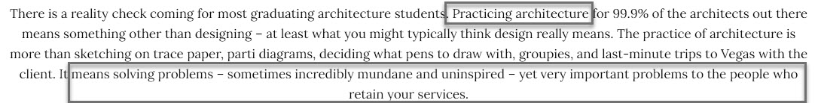

Slide 54
Creating Solutions for Tomorrow
Design: What => How – after establishing Why
Think with broad scope and long vision (occasionally deep as well)
Organize in roadmaps: stepping stones with value and realistic scope
Listen and Learn
Decide
Visualize
Communicate
Enable
Have fun!

Slide 55

Danke Schön Thank you Dank u wel
lucas.jellema@amis.nl | technology.amis.nl | @lucasjellema | lucas-jellema

Slide 56
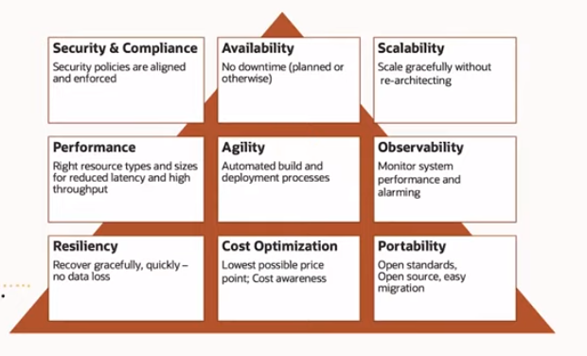
Architecture aspects/concerns

Slide 57
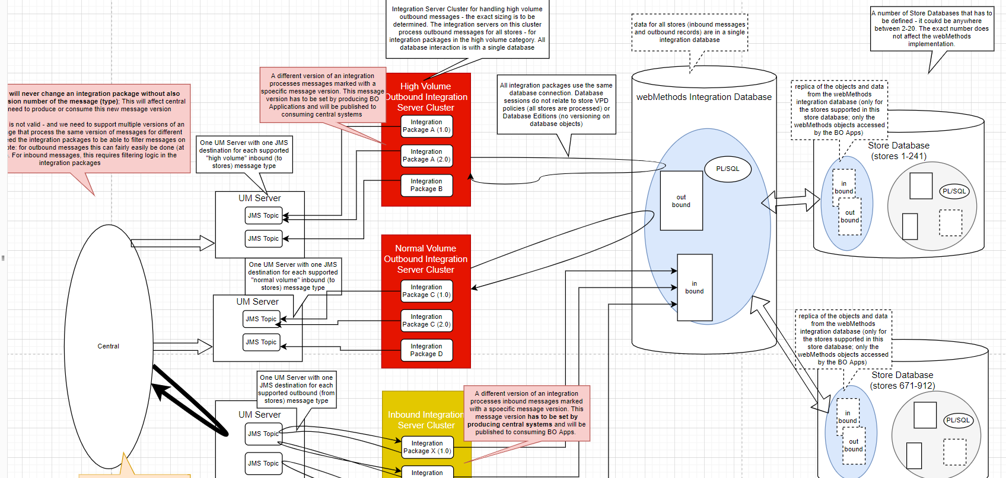

Slide 58
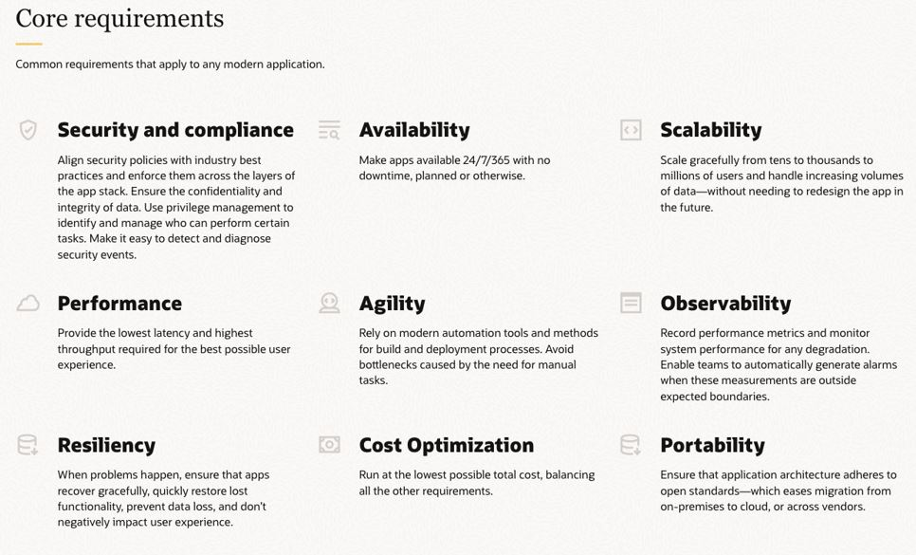
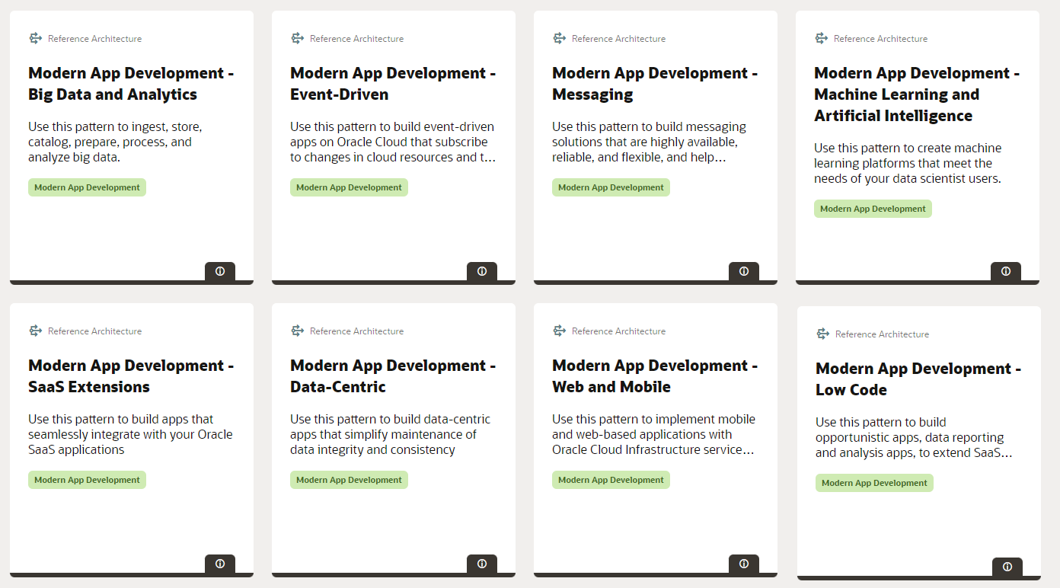
Notes:
https://blogs.oracle.com/cloud-infrastructure/post/simplify-application-development-innovate-faster--deliver-value
https://docs.oracle.com/solutions/?q=&cType=modern-app-development

